Slide 1
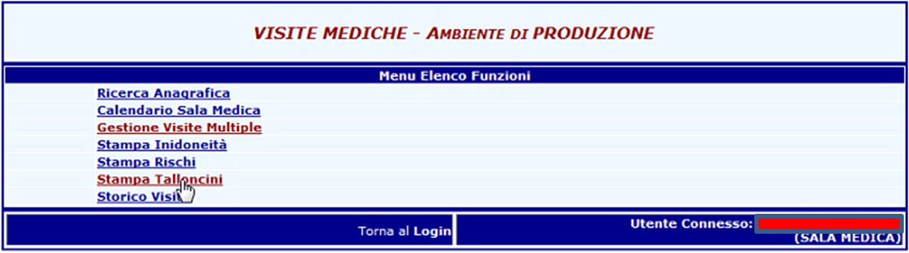
Home page

Slide 2
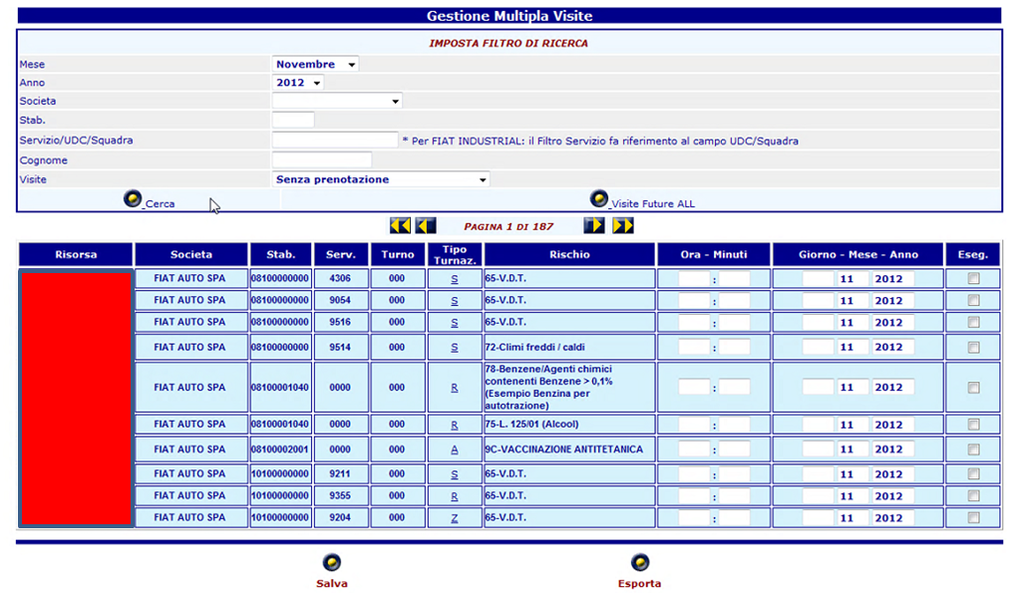
Desk for searching medical checks
3 criteria for searching:
Medical checks without reservation (to reserve)
Medical checks reserved but still not done
Medical checks done
You can search all employees for which
doctor has to reserve medical checks

Slide 3
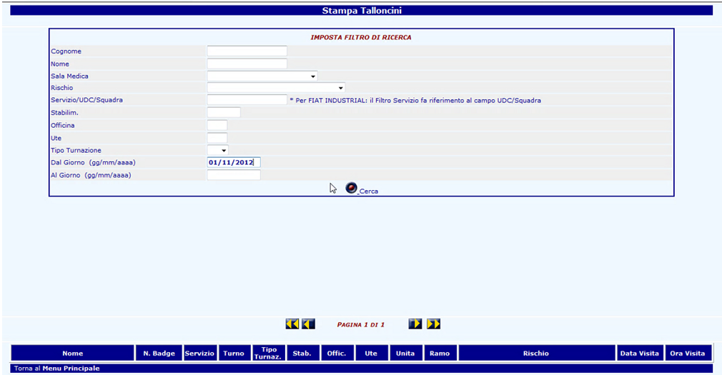
Desk for printing talloncini
You can print "talloncini", that’s coupons for employees, in massive way

Slide 4
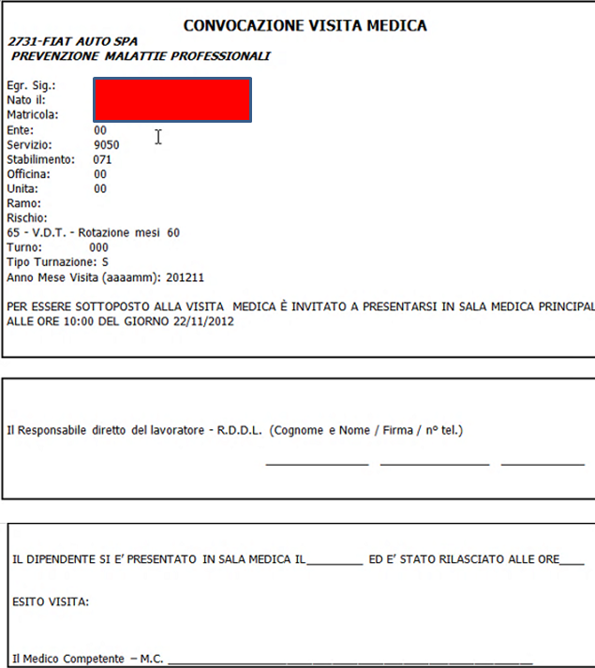
"talloncino", that’s coupon for employee

Slide 5
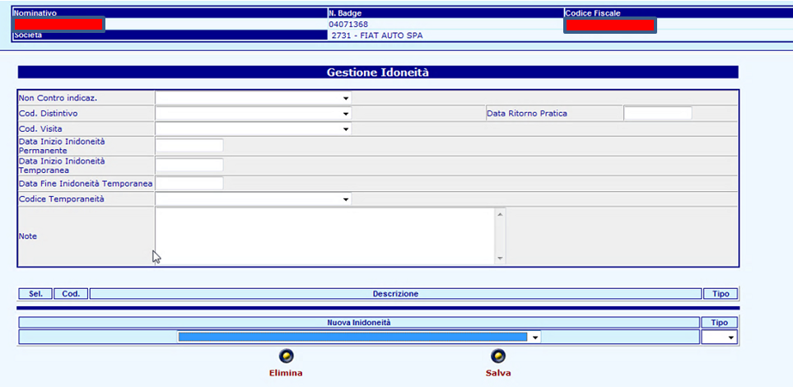
Desk for "non qualification" management - 1/2
List of risks for which the employee didn’t pass the medical check in order to inform also the supervisor.
See next slide

Slide 6
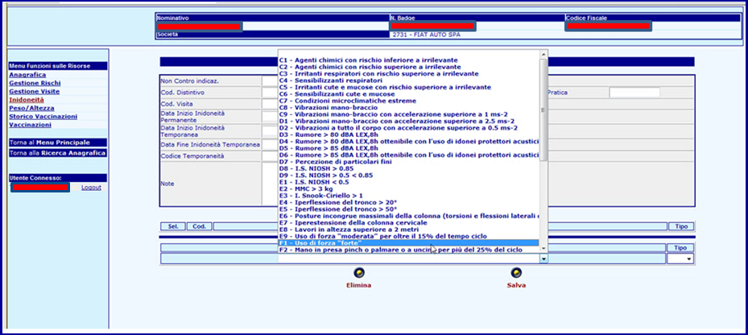
Desk for "non qualification" management - 2/2

Slide 7
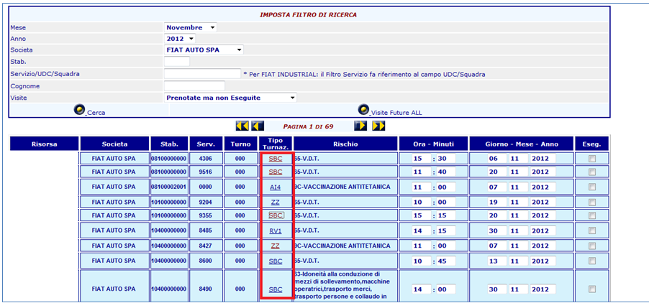
Desk in order to know the shift of each employee - 1/2

Slide 8
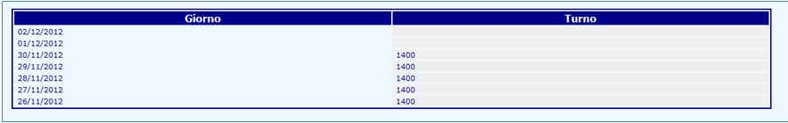
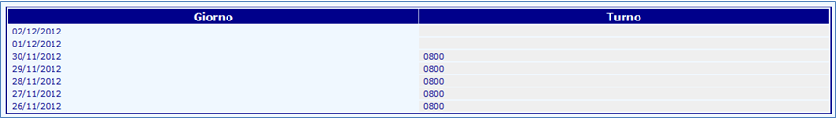
Desk in order to know the shift of each employee - 2/2
Example 1
Example 2

Slide 9
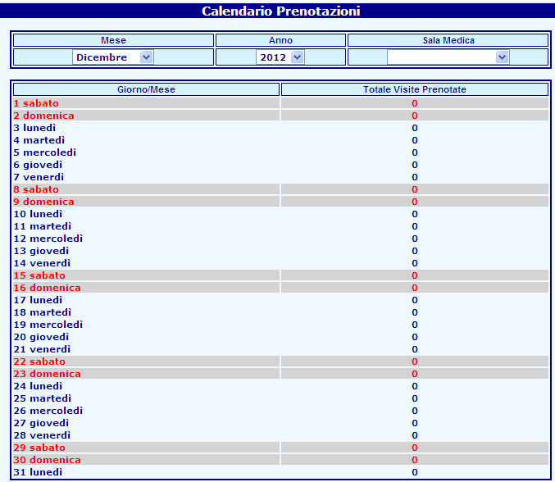
Calendar - recap of medical checks planned

Slide 10
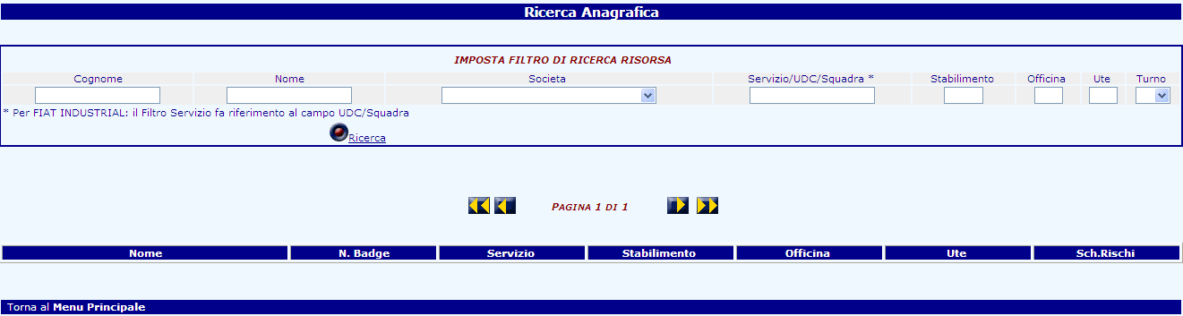
Personal data searching of employees - 1/3

Slide 11
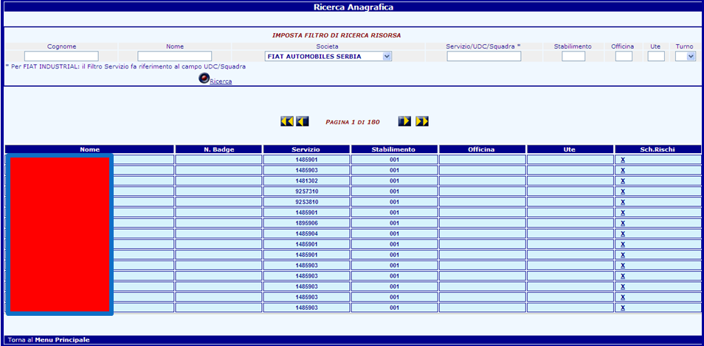
Personal data searching of employees - 2/3

Slide 12
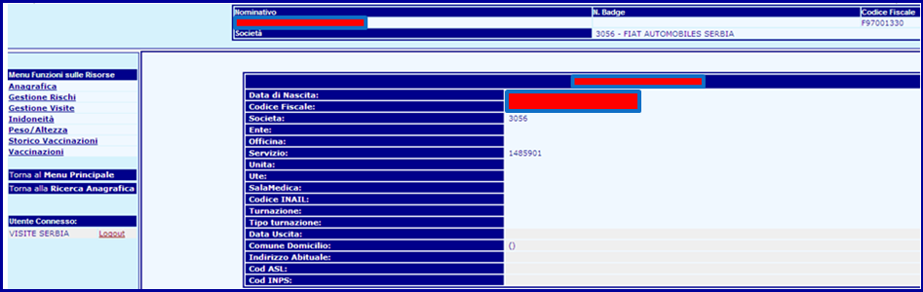
Personal data searching of employees - 3/2

Slide 13
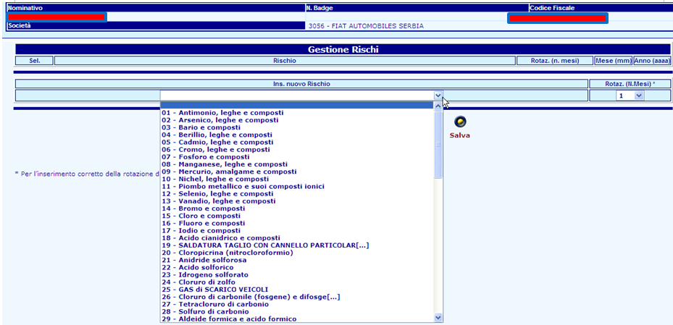
Risk management - add risks in the tool

Slide 14
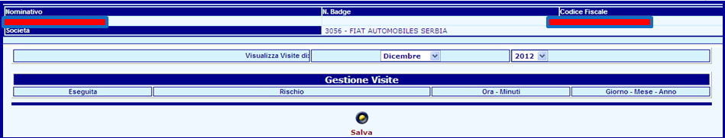
Historical of medical checks

Slide 15
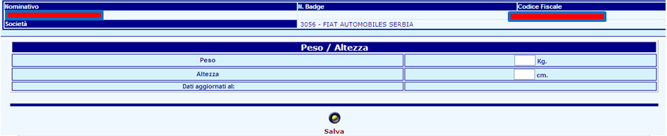
Physical data of employee

Slide 16
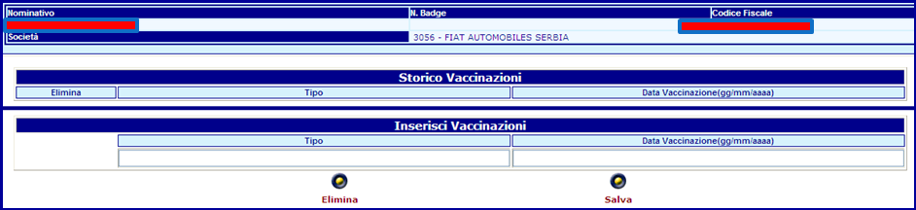
Historical of Vaccines

Slide 17
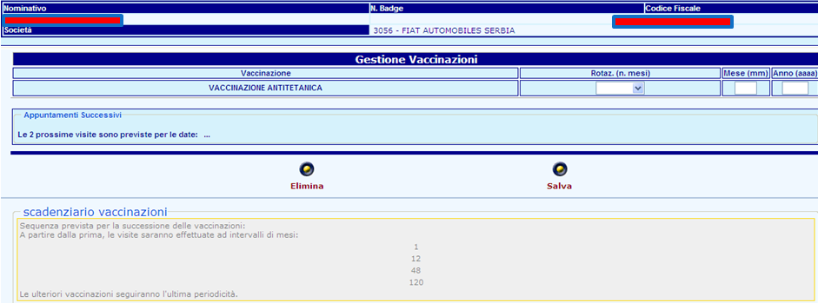
Vaccines management

Slide 18
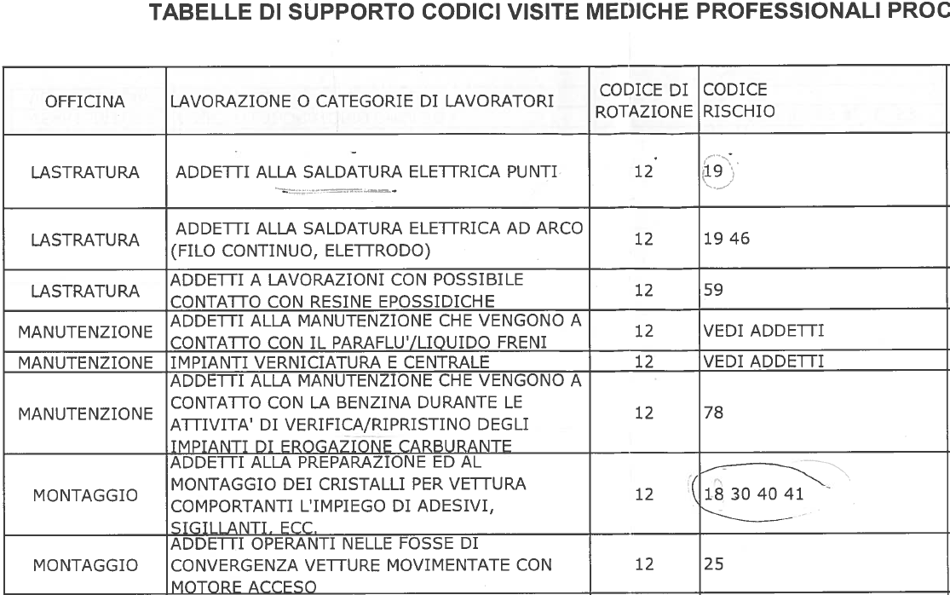
Libraries - Risks
1
2
3
4
5
1 - Agents in charge to electric welding
2 - Agents in charge to arc electric (continue wire, electrode)
3 - Agents in charge to activities with possible contact with epoxy resin
4 - Agents in charge to activities with possible contact with paraflu/brake liquid
5 - painting and central plant

Slide 19
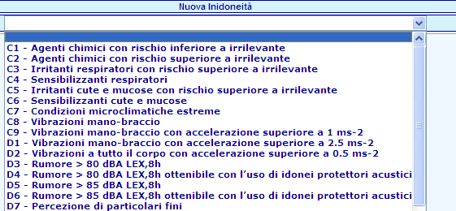
Libraries - Disabilities
C1 - chemistry agents with less risk than to irrelevant
C2 - chemistry agents with more risk than to irrelevant
C3 - Stinging respiratory with more risk than to irrelevant
C4 - Sensitize respiratory
C5 - Stinging skin and mucosa with more risk than to irrelevant

